Slide 1
Feel Like Home (aka FLH) A home rental company
Data Analysis

Slide 2
Introduction
2. Objectives
3. Data Life Cycle
4. Importing and reading the dataset
5. Handling missing values
6. Data Analysis, Insights and Results
Content
Table

Slide 3
Introduction
As a data analyst at "Feel Like Home" (FLH), we have faced a significant decline in revenue due to COVID-19 restrictions. With the gradual lifting of these restrictions, travel is increasing, presenting an opportunity to maximize our revenue by leveraging data-driven insights.
By utilizing the FLH dataset containing various attributes like listing ID, name, host ID, host name, neighborhood group, neighborhood, latitude, longitude, room type, and price in dollars. We can perform comprehensive data analysis to uncover actionable insights.

Slide 4

Objectives
Target High-Demand Neighborhoods
Optimize Pricing Strategies
Identify Successful Property Types
Understand Customer Preferences
Enhance Host Attributes
Boost Traction for Unpopular Properties

Slide 5
Data Life Cycle
In the first phase, the data is captured and loaded into various environments, here python.
Next step is to read the dataset, its attributes, shape(rows and columns) and start cleaning
the data.
Then comes Exploratory Data Analysis, where we get to understand our data and derive meaningful insights.

Slide 6
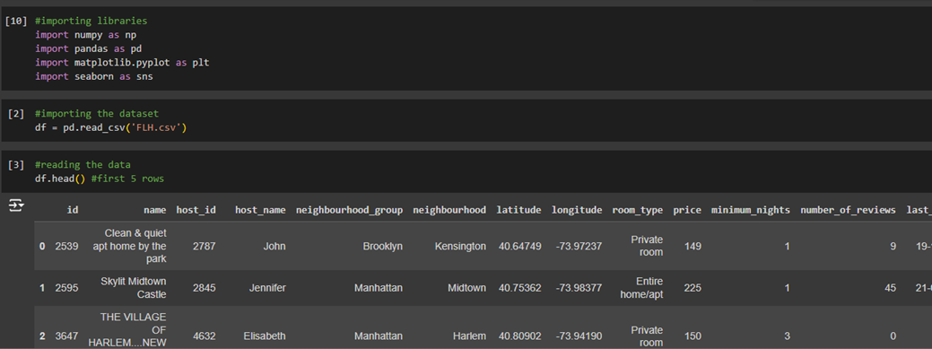
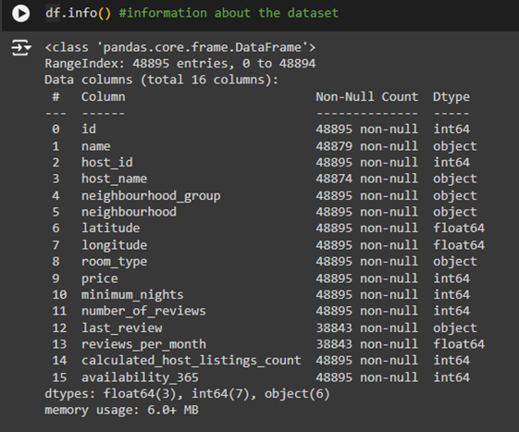
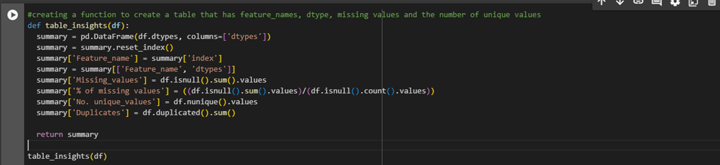
Importing libraries and reading the dataset

Slide 7
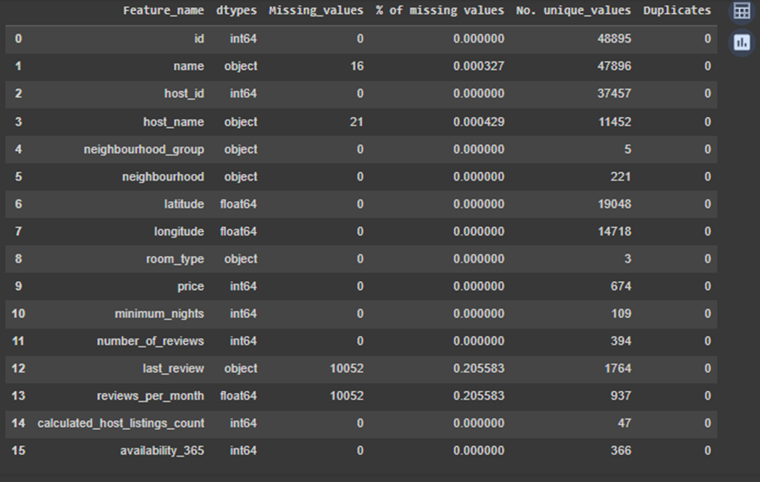
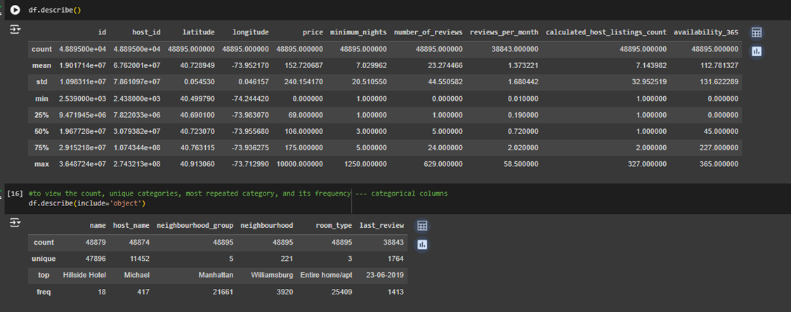
Observations:
The dataset comprises of 48,895 rows with 16 columns.
The columns with null values are 'name', 'host_name', 'last_review' and 'reviews_per_month', with the latter two having 10,052 null entries.
There are no duplicate values in the dataset.
The 'number_of_reviews','price','reviews_per_month', 'availability_365' columns seem to have outliers, but as we are only analyzing the data, I think it's okay to proceed without handling the outlier.

Slide 8
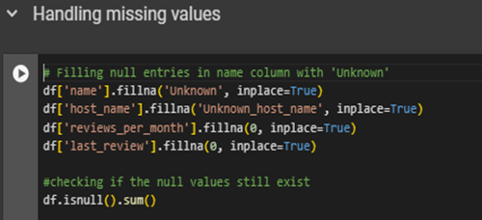
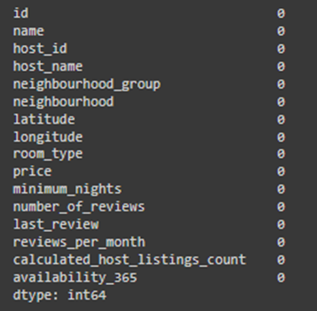
Here I am filling the null values with 0 and 'unknown' for numerical and categorical column respectively, I have not deleted any record or any other imputation as we are only analyzing the given data.

Slide 9
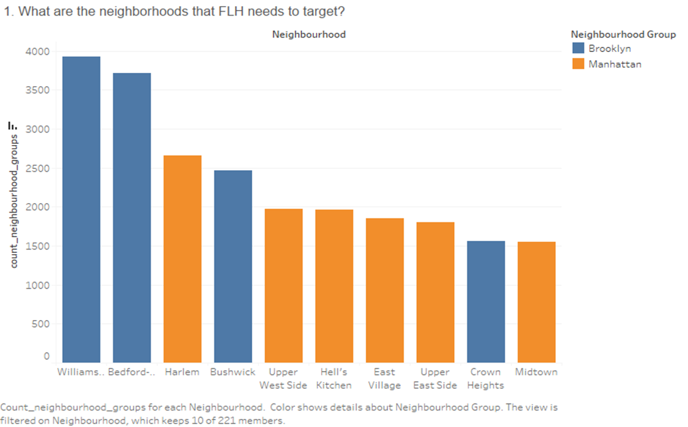
Q1. What are the neighborhoods that FLH needs to target?
Target Neighborhoods for FLH
High Priority Neighborhoods: Based on the data, FLH should focus on neighborhoods with the highest listing counts.
85 % of the listing are Manhattan and Brooklyn neighbourhood_group
Brooklyn: Williamsburg (3920), Bedford-Stuyvesant (3714), Bushwick (2465)
Manhattan: Harlem (2658), Upper West Side (1971)
These areas have demonstrated high customer demand and should be targeted for marketing and property acquisition efforts.

Slide 10
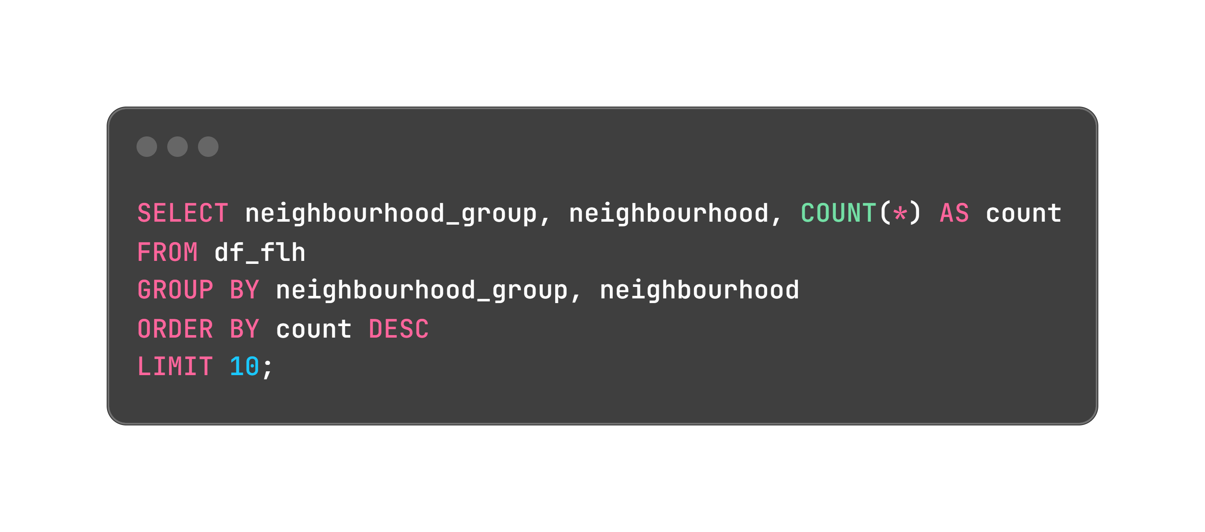
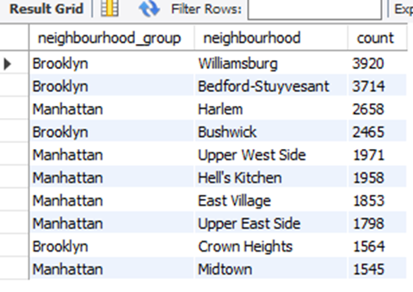
Identifying neighborhoods with the highest demand can help FLH focus its marketing and expansion efforts in areas that are most likely to attract customers.
Targeting neighborhoods with the highest number of listings can help FLH focus marketing efforts where there is already a high demand. Investing in these areas with promotions and better services can further attract more customers, thereby increasing revenue.

Slide 11
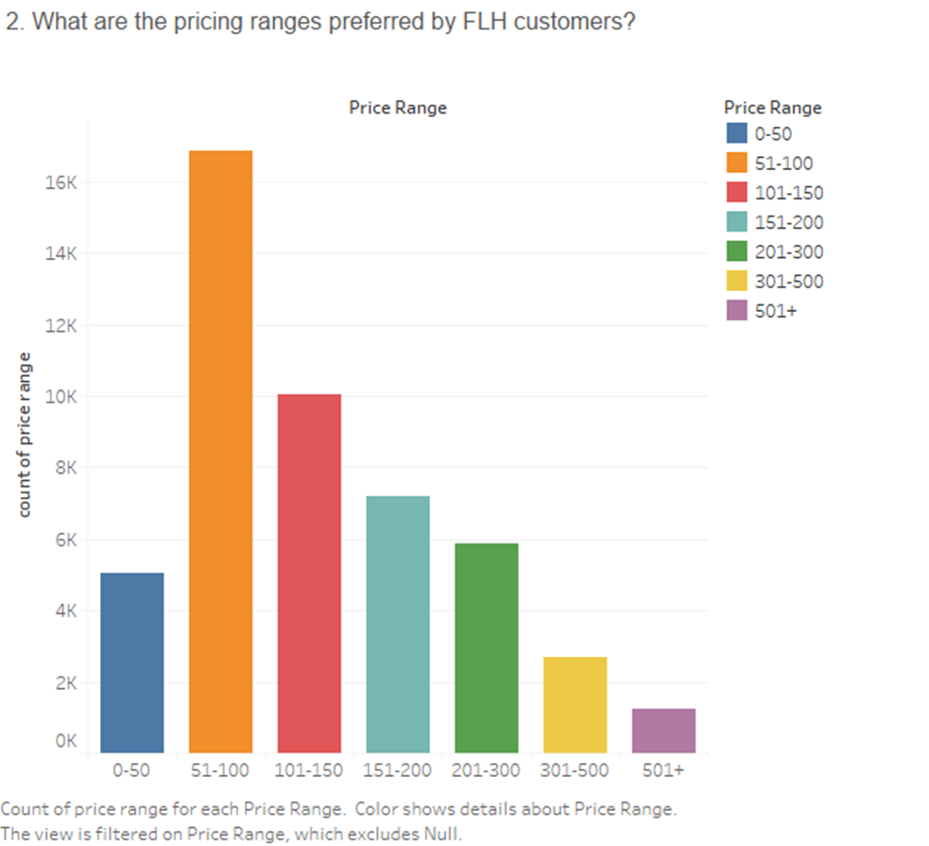
Q2. What are the pricing ranges preferred by FLH customers?
Preferred Pricing Ranges by FLH Customers
The data shows that the majority of FLH customers prefer prices between $50 and $150 per night, with the most popular price point being $100 per night.
Around 15% of customers are willing to pay between $150 and $200.
Entire home/apt listings have the highest number of listings in this price range, followed by private rooms and then shared rooms.

Slide 12
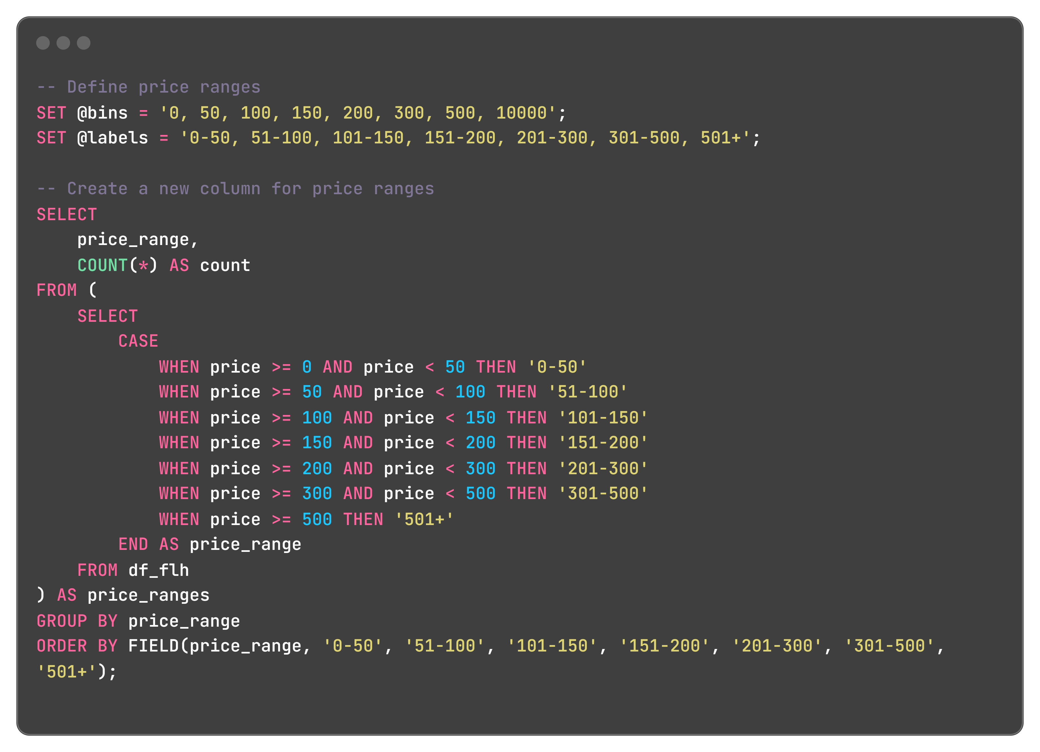
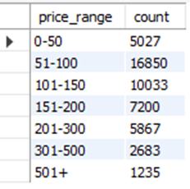
'$51-100': This range has the highest count of bookings (16850), indicating strong preference.​
'$101-150': Also popular, with 10033 bookings.​
Focusing on properties within these price ranges could maximize revenue.​

Slide 13
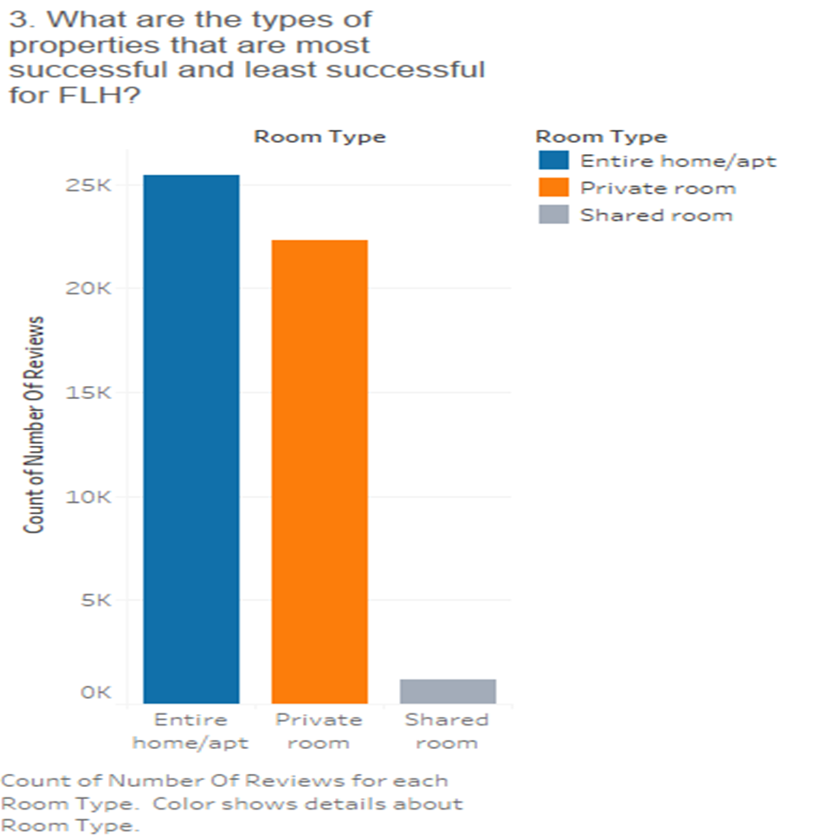
Q3. What are the types of properties that are most successful and least successful for FLH?
Identifying the most successful property types allows FLH to prioritize these in marketing and investment.
Most and Least Successful Property Types
Most Successful:
Entire home/apt have the highest count of number of reviews (25409), suggesting high customer satisfaction and repeat bookings.
Least Successful:
Shared Rooms show the lowest count of number of reviews (1160) indicating lower popularity or satisfaction.

Slide 14
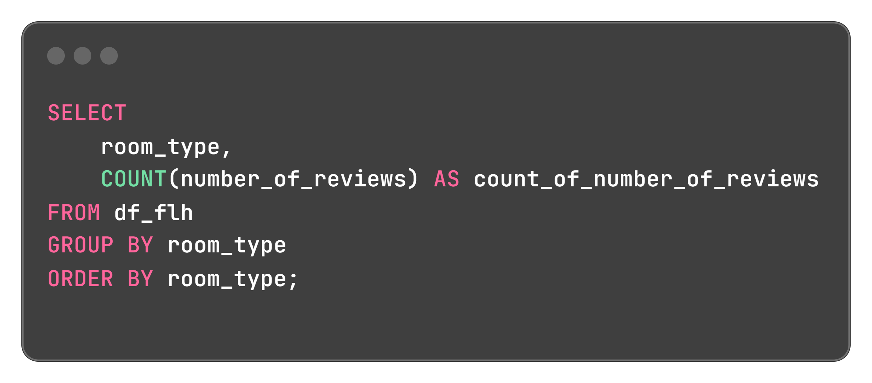
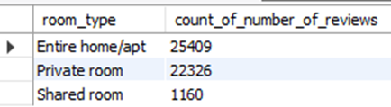

Slide 15
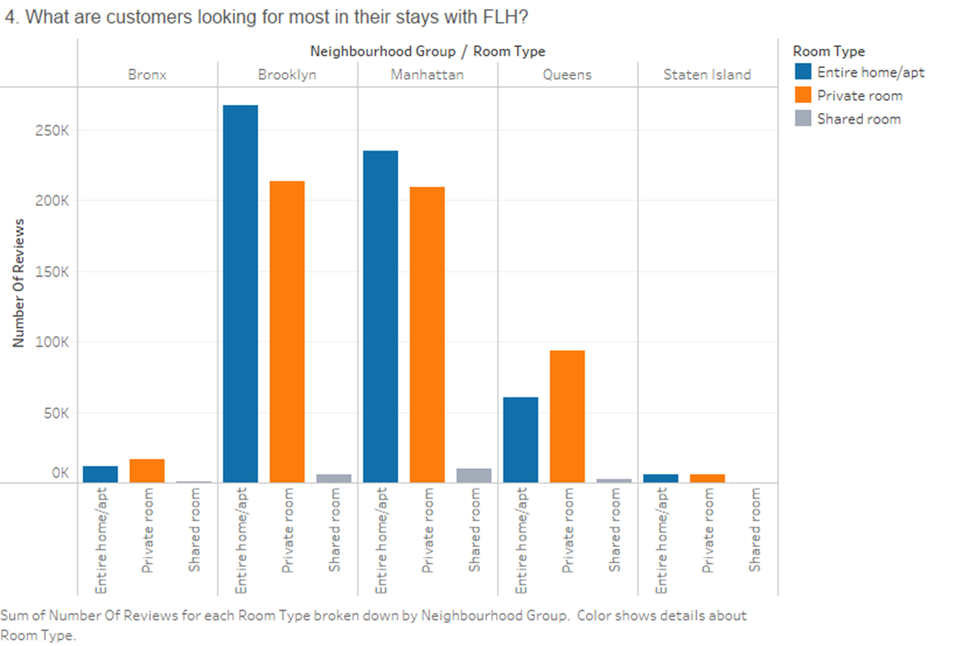
Q4. What are customers looking for most in their stays with FLH?
Neighborhood Group Popularity:
Brooklyn and Manhattan have the highest total number of reviews.
Queens has a noticeable but lower number of reviews compared to Brooklyn and Manhattan.
Bronx and Staten Island have the lowest number of reviews

Slide 16
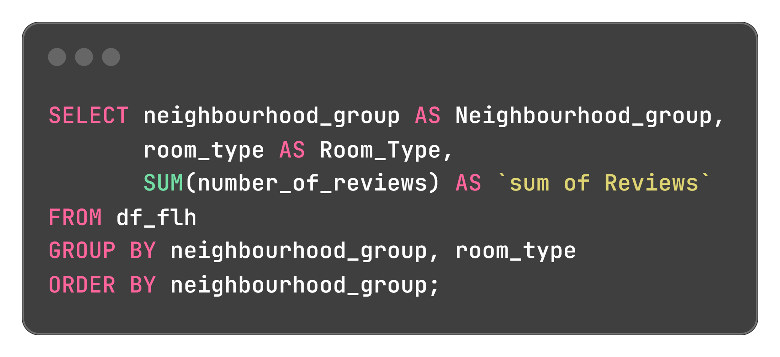
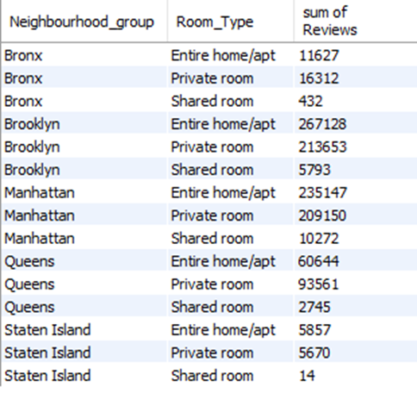
Room Type Preferences:
Entire home/apt consistently has the highest number of reviews, making it the most popular room type.
Private rooms are also popular, especially in Brooklyn and Manhattan.
Shared rooms have the fewest reviews, indicating they are the least preferred.
Comparison Between Neighborhoods:
In Brooklyn and Manhattan, reviews for Entire home/apt and Private rooms are close, with Entire home/apt leading.
In Queens, Private rooms have more reviews than Entire home/apt, which is unique compared to other neighborhoods.
Most of the properties are offering either a Private room or the Entire home/apt, there are very few properties which are offering a Shared room. The reason for this can be that most of the tourists or visitors want privacy and prefer either a private room or to have the entire home/apt for themselves for their convenience.
Queens shows a relatively higher interest in private rooms, which could be an opportunity for targeted marketing and improvements in that segment.

Slide 17
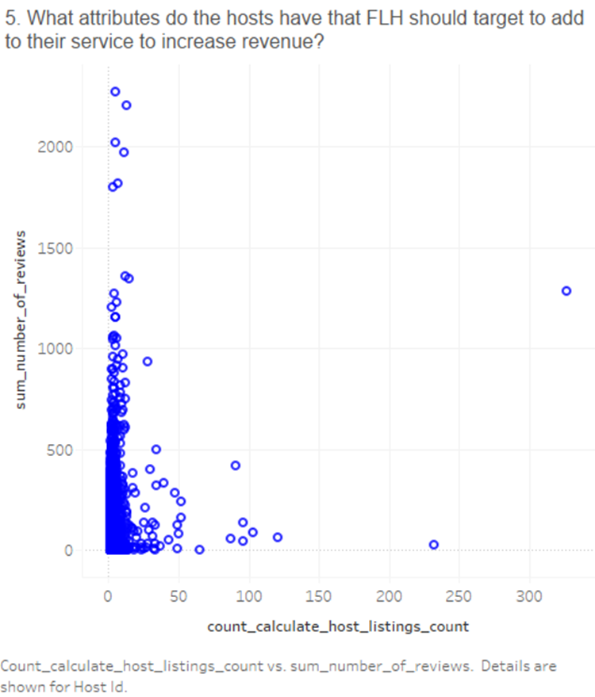
Q5. What attributes do the hosts have that FLH should target to add to their service to increase revenue?
Attributes of Hosts to Target for Increasing Revenue
Hosts with High Listing Counts: Hosts like Sonder (NYC) (327 listings) and Blueground (232 listings) manage a large number of properties, indicating experience and capability in handling multiple listings.

Slide 18
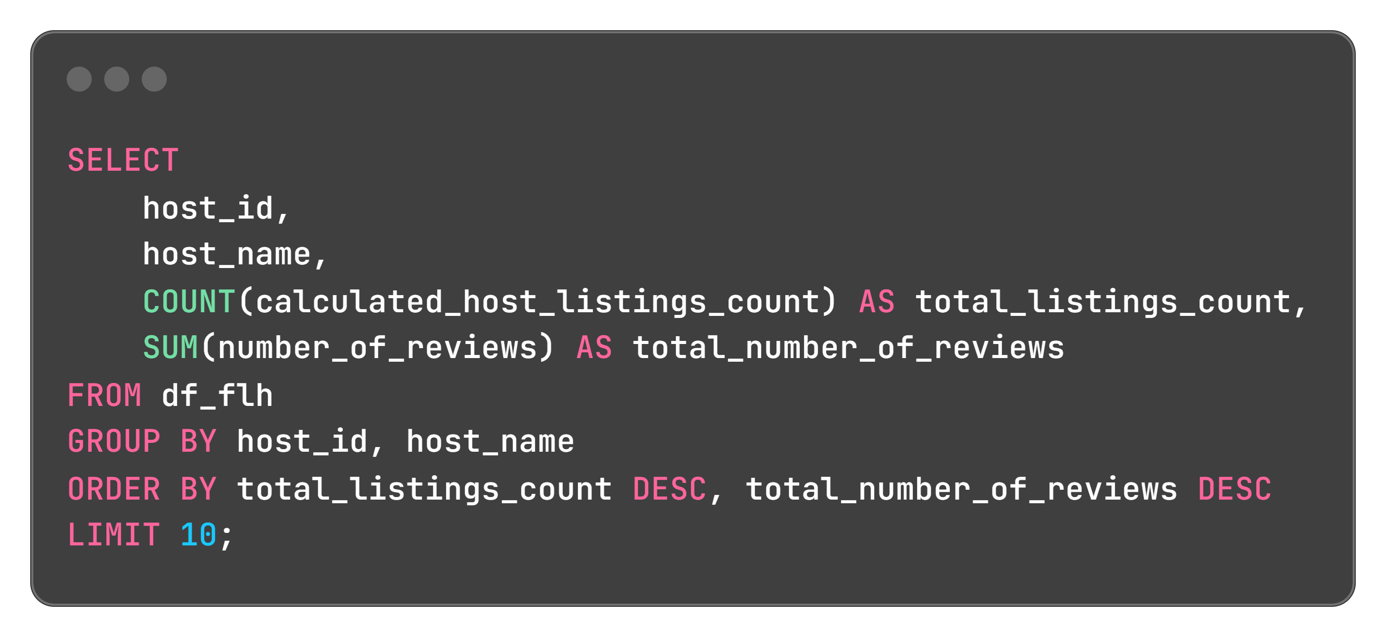
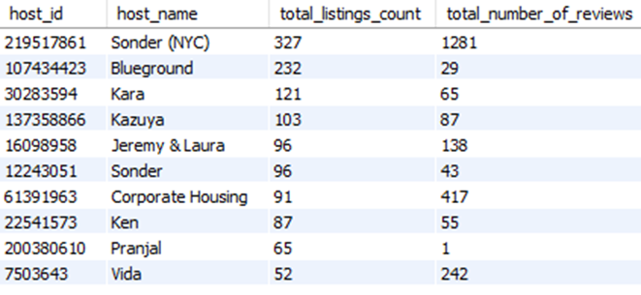
Identifying the top hosts is important as it can lead to collaborations, recognition, and potential incentives for these hosts. Recognizing and rewarding top hosts could encourage them to continue providing exceptional service, contributing to positive customer experiences and loyalty.
Focus on Experienced Hosts: Targeting hosts who manage multiple listings effectively can help ensure a consistent, quality experience for FLH customers, potentially increasing bookings and revenue.

Slide 19
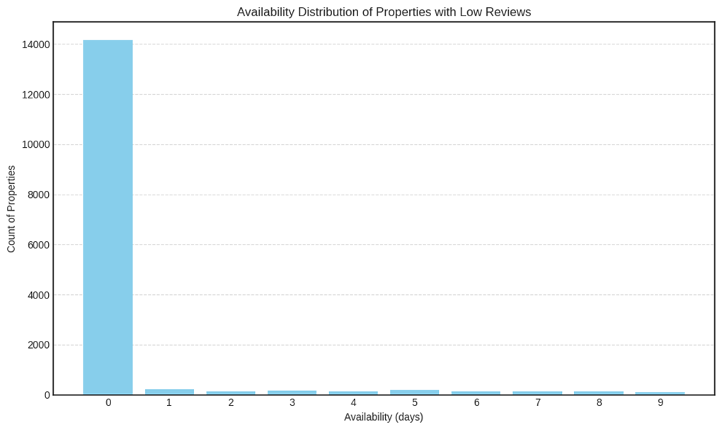
Q6. How to get unpopular properties more traction?
1. Highly Available Properties: A significant number of properties (14,164) have an availability of 0 days, indicating they may not be available for rental throughout the year. This suggests these properties might have limited availability or are not actively rented out.
2. Limited Availability: As availability days increase from 1 to 9, the number of properties decreases, indicating that fewer properties have higher availability throughout the year. This highlights variability in rental availability among these properties.

Slide 20
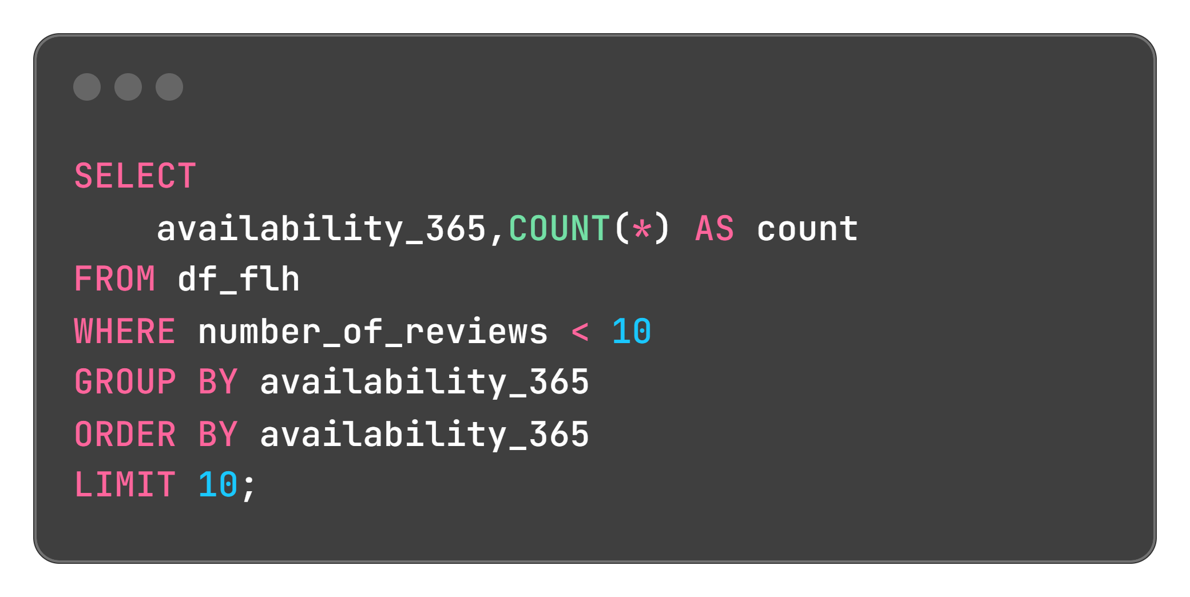
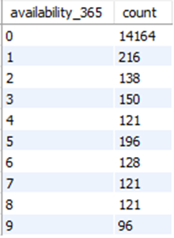
3. Seasonal or Periodic Availability: The distribution shows peaks and valleys, suggesting that some properties may be available only during specific seasons or periods. This variability in availability can impact rental income potential across different times of the year.
4. Potential Impact on Revenue: Properties with higher availability (closer to 365 days) have the potential to generate more revenue if effectively managed. Properties with lower availability may require adjustments in pricing or marketing strategies to optimize revenue.
5. Operational Insights: This analysis can guide operational decisions such as adjusting cleaning schedules, implementing pricing strategies tailored to peak and off-peak periods, and forecasting revenue based on availability trends. Understanding these patterns helps in optimizing rental management and maximizing revenue from the properties.

Slide 21
To improve:
Targeted Marketing: Focus marketing efforts on specific neighborhoods and room types that are identified as unpopular to boost their visibility.
Pricing Strategy: Review and adjust pricing based on the average prices of similar properties in the same neighborhood to ensure competitiveness.
Improving Property Features: Enhance the amenities and features of the properties based on feedback or common features of more popular properties.
Optimizing Listing Descriptions: Use attractive and clear descriptions, high-quality photos, and update them regularly to attract more interest.
By systematically addressing these areas through data analysis and targeted strategies, FLH can effectively increase the visibility, attractiveness, and ultimately the revenue of its less popular properties.

Slide 22
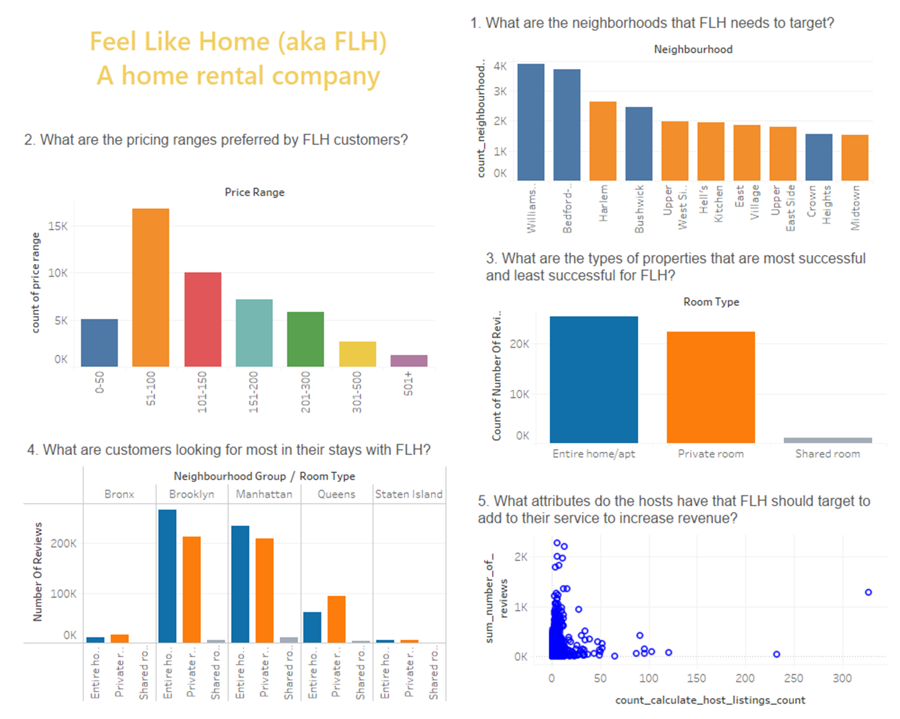

Slide 23
Thank you!
Va

